Slide 1





Hello Everyone!
I am Syeda Nowshin Ibnat
And I am here today because I love to give presentation.
Dept. of CSE
Intake 39(sec-1)

Slide 2
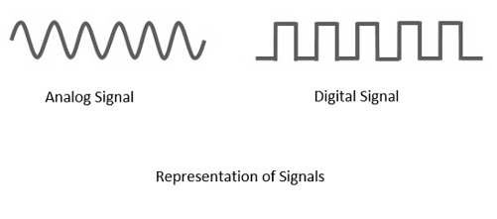
Transmission of Digital Signals

Slide 3
What is Digital Signal?
A digital signal refers to an electrical signal that is converted into a pattern of bits.
Unlike an analog signal, which is a continuous signal that contains time-varying quantities, a digital signal has a discrete value at each sampling point.
The precision of the signal is determined by how many samples are recorded per unit of time.

Slide 4
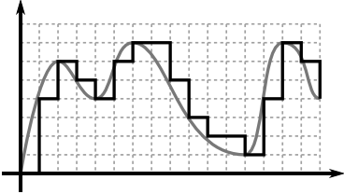
For example, the illustration below shows an analog pattern (represented as the curve) alongside a digital pattern (represented as the discrete lines)

Slide 5
How can we send a digital signal from a point to another point?
We can transmit a digital signal by using one of two different approaches:
baseband transmission
broadband transmission (using modulation).

Slide 6
Contents
About
Working method
Applications
Advantages
Disadvantages
Difference between them

Slide 7









1. Baseband Transmission

Slide 8
About:
Baseband transmission means sending a digital signal over a channel without changing the digital signal to an analog signal.
Baseband has a low-frequency contained within the bandwidth frequency close to 0 hertz .
This type of signals are transmitted without modulation.
Baseband can be synonymous with low pass or non-modulated signal.

Slide 9
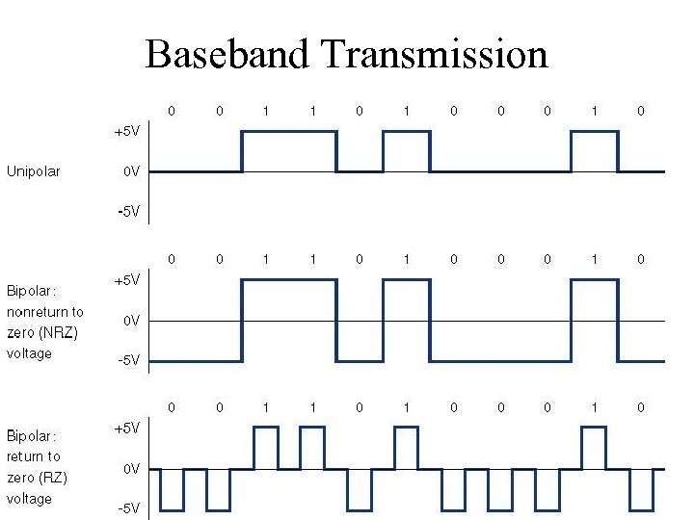

Slide 10
Working Method
Baseband transmissions typically use digital signaling over a single wire.
The digital signal used in baseband transmission occupies the entire bandwidth of the network media to transmit a single data signal.
Baseband communication is bidirectional, allowing computers to both send and receive data using a single cable. But the sending and receiving cannot occur on the same wire at the same time.

Slide 11
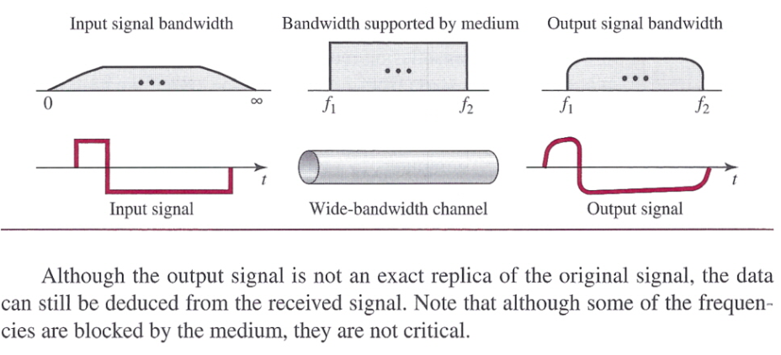
Baseband Transmission using a dedicated medium

Slide 12
Application
Advantages
Disadvantages
Ethernet
Photo biology
Electronic devices for LED lighting
Digital television
Simplicity
Low cost
Ease of installation and maintenance
High rates
Limited distances
Data and voice only.

Slide 13


2. Broadband Transmission

Slide 14
About:
Broadband transmission or modulation means changing the digital signal to an analog signal for transmission.
In telecommunication, broadband is wide bandwidth data transmission which transports multiple.
The medium can be coaxial cable, optical fiber, radio or twisted pair.

Slide 15
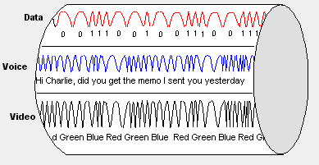

Slide 16
Working method:
Broadband transmissions are divided into multiple bands or channels by multiplexers using a multiplexing scheme such as frequency-division multiplexing (FDM).
Each channel has a carrier frequency that is modulated to carry the signal from a given source.
At the receiving station, multiplexers separate the various signals.

Slide 17
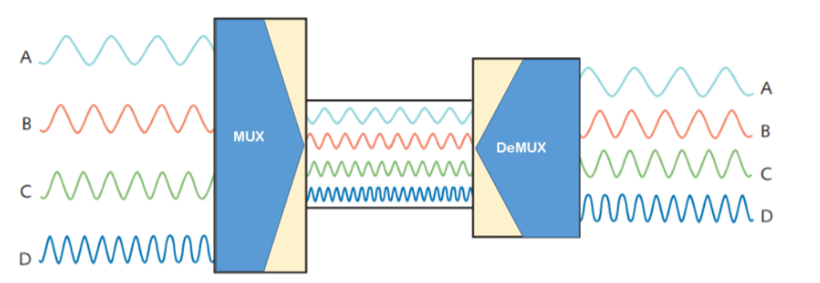
The following image shows an example of FDM process.

Slide 18
Application
Advantages
Disadvantages
Data, voice and video can be accommodated on broadband channel
Greater distances
Greater bandwidth.
Cable design
Alignment and maintenance
High cost, requires modems
Lack of well-developed standards.
Cable Modem
FTTH(fiber to the home)
Satellite
Mobile Wireless

Slide 19
Difference between baseband and broadband transmission
Baseband Transmission | Broadband Transmission
Digital signaling. | Analog signaling.
Frequency division multiplexing is not possible. | Signal travelling distance is long.
Baseband is bi-directional transmission. | Transmission of data is unidirectional.
Short distance signal travelling. | Frequency division multiplexing possible.
Entire bandwidth is for single signal transmission. | Simultaneous transmission of multiple signals over different frequencies.

Slide 20
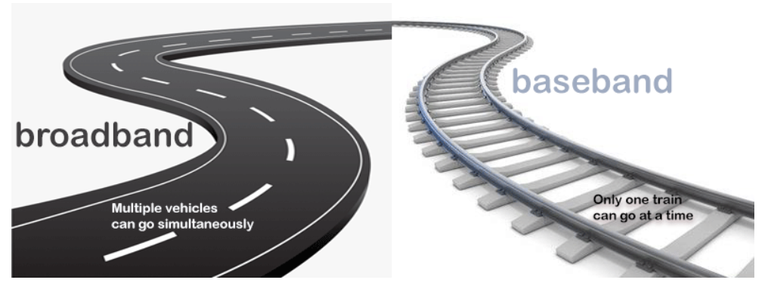
In a word

Slide 21
References:
https://www.wikipedia.org/
https://www.geeksforgeeks.org/
https://www.slideshare.net/
And some more websites

Slide 22
If you can dream it, you can do it.
Walt Disney

Slide 23

Thank You!

